Slide 1

Stockex
Meeting Room 4 Team 2, 2025/-8/-1 10:00 GMT+8
Notes:
[GU] Greetings all, we are Team 2 from Meeting Room 4 which is honored to be here, introducing Stockex, the project work of our team.

Slide 2




Architecture
Stockex, the site
(NUEDAOFL2RNEXP2RJ)
Project Overview
Our Team
Portfolio
The index page of this site enabling clients to make managements on stocks they’ve purchased, showing basic info & gain, loss of buy-in
The subpage guided from the index page, offering info on conversion and overall trend of ForEx which is updated on regular basis
Stocks Page
The leader
45448721
Pengqi GU
developer
Current Trend
Frontend
Layer
Design (Elems & CSS)
Frontend JS (on elems)
Forex Page
Git review & merge
Backend API
Stocks Database
Stocks Name
45452481
Dongxin DU
developer
API
Current Trend
Frontend JS (on charts)
Backend SQL
Forex Database
Stocks Stats
Past Month
Currency Name
45431534
Yujiao CHEN
developer
Backend SQL
Backend API
Foreign Exchange Stats Past Month
Backend
Layer
Kai JIANG
45434037
developer
Design (Elems)
Frontend JS (on elems)
Backend API
Notes:
I’m proud to introduce my team members above all – GU, DU, CHEN and JIANG, who are all developers, will guide you through this project.
The project is aimed to (CLICK) provide information for both STOCKS and Foreign Exchange (or ForEx), being displayed on separate pages. The one for stocks is …, and (CLICK) the forex page is the sub one guided….
Now, (CLICK) let’s come to steps we have to go through before putting what API features in front of our portfolio. Take the index page as an example – our team will first (CLICK) get data in the past month from APIs to obtain (CLICK) a database which features (CLICK) the name and trend. (CLICK) The data will be displayed on page after some operations and then (CLICK) enables the portfolio to custom in their favor. (CLICK) The stocks page also features a bar that guides the client to forex page, (CLICKS) which shares the same overall architecture with stocks as it gets data to shape the database, use database for on-page data display and gets the page ready for the portfolio.
The architecture can be separated into double layers, (CLICK) as there’re 3 developers of the 4 who were involved in the frontend layer. (CLICK) When it comes to the backend one, all of us were involved. (CLICK) For me myself as a leader, I’m also assigned to be the git reviewer, merging codes among branches.

Slide 3
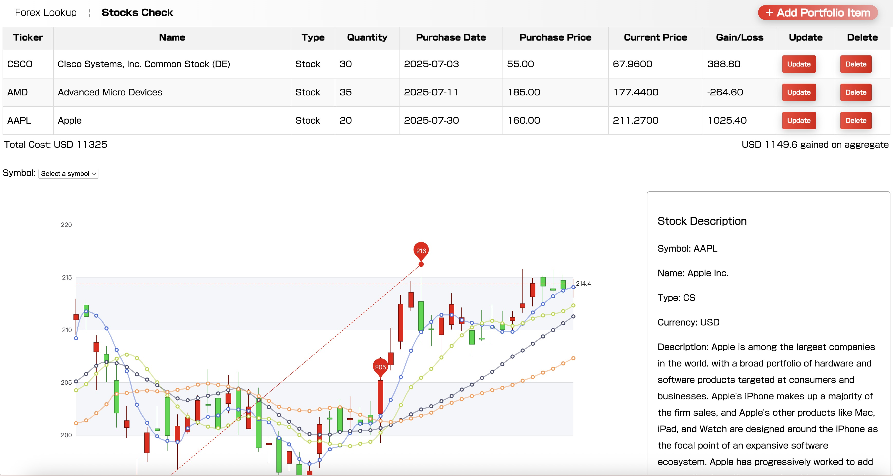
On Stage Feature: Stocks Check
Notes:
Now let’s make some scratches on what our project may feature. As the landing page of the whole site, the stocks check page enables clients to search, add, update & delete their previously-bought stocks to My Tickers. Description and candlesticks of up to 20 leading stocks in the market is available for handy check, shown below.

Slide 4
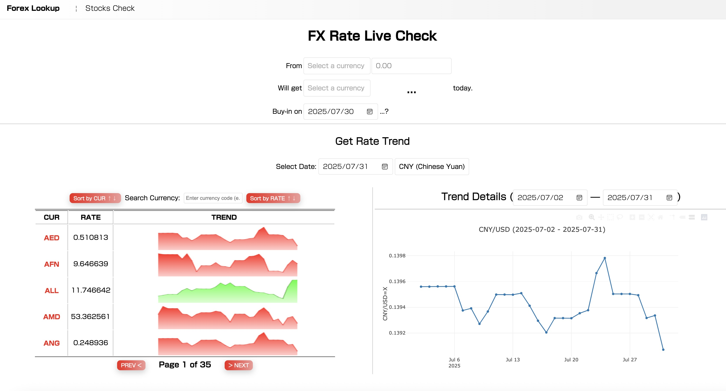
On Stage Feature: ForEx
Notes:
And here’s the page supporting the forex look-up. The page can show how much the client may have gained or lost today for the previous bid for foreign exchange and also support both a brief & a detailed line graph showing the overall trend of FX rate among up to 150+ currencies.
For more information on how the pages is to work, please wait for the demonstration phase to come up.

Slide 5
Behind the Stage – Tech Stacks
Backend
API
OpenExchange
TwelveData
Polygon
Alpha
SQL
MySQL
API
Notes:
Now let’s think about what lies behind the stage. It all starts from APIs at the backend, as our team employed up to 4 APIs for more accurate and live financial news and stored data in databases via MySQL. Jade Y CHEN will tell you more.

Slide 6
Behind the Stage – Tech Stacks
Data Fetch from third-party APIs
Create SQL table via JS
Send get, the request from JS
Get data from APIs when the table is empty
Get latest entries from the table otherwise
Stocks Database
API
Forex Database
Stocks Stats
Past Month
Foreign Exchange Stats Past Month
Notes:
[Jade] Now let's look at the first task: pulling data from a third-party API into local MySQL. First, based on the functionality we need to demonstrate, we determine the third-party API to use and create SQL table via JavaScript and Then, in a GET request, we pass the required parameters and key to retrieve the data. After parsing the data, we insert it into local MySQL. (CLICK) Data with time attributes requires additional processing. When the data table is empty, we pull the most recent data from the third-party API. When the table already has data, we pull the data since the last update to ensure it's always up to date. (CLICK) It is after these steps that we finish setting up our database.

Slide 7
Behind the Stage – Tech Stacks
Stockex, the site
(NUEDAOFL2RNEXP2RJ)
Backend API
Get parameters from frontend
Find specific entries from the database and process the data for computation of P&L
Respond to frontend
Current Trend
Stocks Database
Stocks Name
API
Current Trend
Forex Database
Stocks Stats
Past Month
Currency Name
Foreign Exchange Stats Past Month
Notes:
[Jade] Next, let‘s look at the second task: writing the backend API. Our team afterwards get parameters from interactions at the frontend to find corresponding specific entries from the database, which (CLICK) contains name & trend of both stocks and currency, to process the data for computation of Profit & Loss. The entries will be converted to be JSON (CLICK) before responding them to frontend. The frontend will feature graphs, Kurt will tell you more.

Slide 8
Behind the Stage – Tech Stacks
Frontend Charts
Forex
Plotly for detailed line graph
Canvas for brief view
Stocks
Echart for candlestick
Stockex, the site
(NUEDAOFL2RNEXP2RJ)
Stocks Page
Forex Page
Notes:
[Kurt] Ok, now let's surface back to the frontend. (CLICK) For the forex page, after selecting the functional currency type, the lower left corner of the page will show its exchange rate to other foreign currencies and the trend line chart. The data of the input time series are statistically analyzed in the beginning, and the data values are mapped to the pixel coordinates of canvas, matching with the scale of the chart. After drawing the polyline, the color is filled according to the rise and fall conditions.
In order to carry out these actions on the large trend chart, our team use plotly, a JavaScript-based drawing library for creating interactive charts and data visualizations. The latest version of plotly is imported using some line of code, then newPlot is employed to set the x and y axis data for what has been passed in from the backend, and plot type is set to scatter to reach the graph.
To reach the candlestick chart on Stocks page (CLICK), our team use eCharts. The time series information of stocks from the back end is fetched above all; the date and price data are then extracted into the x-axis and y-axis array as values separately. Axis, grid, legend and tooltip are eventually configured in the option section before the candlestick chart is finished.

Slide 9
Behind the Stage – Tech Stacks
Frontend UI
Get values from backend
JS for corresponding element text changing
Stockex, the site
(NUEDAOFL2RNEXP2RJ)
Stocks Page
Forex Page
Notes:
[Kurt] All charts should display on the page, but the one which displays the brief view on a table is data-free. The duty of making the stats display beside the brief line graph now comes onto Kyran’s shoulder – he will tell you more.
[Kyran] Thank you, Kurt. The frontend UI will get values from backend and JavaScript in the HTML document will take the responsibilities to change corresponding text in the elements.

Slide 10

Behind the Stage – Tech Stacks
Frontend UI
Internal link from topbar
Stockex, the site
(NUEDAOFL2RNEXP2RJ)
Stocks Page
Forex Page
Notes:
[Kyran] Both the pages feature a top bar (CLICK) which gives internal link to and from the stocks and forex, shown (CLICK) here.

Slide 11
Behind the Stage – Tech Stacks
Frontend UI
CSS document reference for final display (entirely designed by our group)
Stockex, the site
(NUEDAOFL2RNEXP2RJ)
Portfolio
Stocks Page
Forex Page
Notes:
[Kyran] Our team has also improved the overall appearance of user interface by referencing CSS files for ultimate display, which is completely designed by our group ourselves. The client (CLICK) will be free to get latest information on both fields afterwards, as our team is firmly convinced that the info has been handy already. (CLICK)

Slide 12
Behind the Stage – Tech Stacks
Done
STAGE SET (Demo>>)
What’s in store in future?
Auto to-name matching for given ticker of a symbol in Stocks Check the section
Dark mode support on pages
Current Trend
Stocks Database
Stockex, the site
(NUEDAOFL2RNEXP2RJ)
Stocks Name
API
Current Trend
Portfolio
Thanks For Listening.
Forex Database
Stocks Stats
Past Month
Currency Name
Stocks Page
Forex Page
Foreign Exchange Stats Past Month
Notes:
[Kyran] Now, the overall stage of our project has been set, and we will show you how the website will work and how the using experience will be like.
(DEMO TIME, presented by Kyran and Kurt)
[Kyran] Now, so much for the demonstration. (CLICK) For our project, auto match for a symbol’s ticker and its name is on the way for stocks item add or updates. Dark mode will also be supported for the page later on, time permitting.
[GU] (CLICK) So, that’s all for our project – thanks for your patient listening & have a good weekend.

